Slide 1
FEATURE SELECTION AND DATASET
INTRODUCTION
Predicting Restaurant Ratings
EDA
METHODOLOGY AND ALGORITHMS
CONCLUSION

Slide 2
SIGNIFICANCE
OBJECTIVE
Predicting restaurant ratings is crucial for both customers and restaurant owners. It allows customers to make informed dining decisions, while restaurant owners can understand and improve their services based on expected ratings.
PROBLEM STATEMENT

Slide 3


OBJECTIVE
The primary objective of this project is to develop a machine learning model that can accurately predict the aggregate rating of a restaurant using various features related to the restaurant's characteristics and operations.

Slide 4
SIGNIFICANCE
OBJECTIVE
Predicting restaurant ratings is crucial for both customers and restaurant owners. It allows customers to make informed dining decisions, while restaurant owners can understand and improve their services based on expected ratings.
PROBLEM STATEMENT

Slide 5


PROBLEM STATEMENT
Develop a machine learning model to predict the aggregate rating of a restaurant based on various
features related to the restaurant's characteristics and operations.

Slide 6
SIGNIFICANCE
OBJECTIVE
Predicting restaurant ratings is crucial for both customers and restaurant owners. It allows customers to make informed dining decisions, while restaurant owners can understand and improve their services based on expected ratings.
PROBLEM STATEMENT

Slide 7
FEATURE SELECTION AND DATASET
INTRODUCTION
Predicting Restaurant Ratings
EDA
METHODOLOGY AND ALGORITHMS
CONCLUSION

Slide 8
FEATURE
1. Restaurant ID: Unique identifier for each restaurant.
2. Restaurant Name: Name of the restaurant.
3. Country Code: Numeric code representing the country where the restaurant is located.
4. City: Name of the city where the restaurant is situated.
5. Address: Physical address of the restaurant.
6. Locality: Locality or neighborhood where the restaurant is located.
7. Locality Verbose: Detailed description of the locality.
8. Longitude: Geographical longitude of the restaurant's location.
9. Latitude: Geographical latitude of the restaurant's location.
10. Cuisines: Types of cuisines offered by the restaurant.
11. Average Cost for Two: Average cost for a meal for two people.
12. Currency: Currency used for transactions in the restaurant.
13. Has Table Booking: Indicator of whether the restaurant accepts table bookings.
14. Has Online Delivery: Indicator of whether the restaurant offers online delivery.
15. Is Delivering Now: Indicator of whether the restaurant is currently delivering.
16. Switch to Order Menu: Indicator of whether the restaurant has switched to an order menu.
17. Price Range: Price range category of the restaurant.
18. Aggregate Rating: Overall rating of the restaurant.
19. Rating Color: Color code representing the rating.
20. Rating Text: Text description of the rating.
21. Votes: Number of votes received by the restaurant.
Dataset

Slide 9
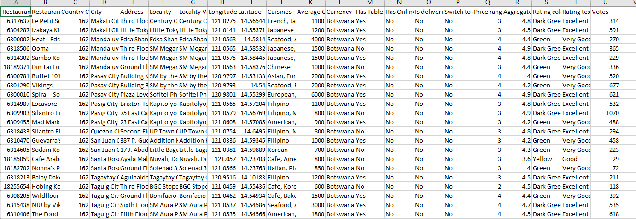
Dataset Overview
Shape of the Dataset:
Rows: 9,551
Columns: 21
Column Types:
Discrete: 5 columns
Continuous: 3 columns
Categorical: 13 columns

Slide 10
FEATURE
1. Restaurant ID: Unique identifier for each restaurant.
2. Restaurant Name: Name of the restaurant.
3. Country Code: Numeric code representing the country where the restaurant is located.
4. City: Name of the city where the restaurant is situated.
5. Address: Physical address of the restaurant.
6. Locality: Locality or neighborhood where the restaurant is located.
7. Locality Verbose: Detailed description of the locality.
8. Longitude: Geographical longitude of the restaurant's location.
9. Latitude: Geographical latitude of the restaurant's location.
10. Cuisines: Types of cuisines offered by the restaurant.
11. Average Cost for Two: Average cost for a meal for two people.
12. Currency: Currency used for transactions in the restaurant.
13. Has Table Booking: Indicator of whether the restaurant accepts table bookings.
14. Has Online Delivery: Indicator of whether the restaurant offers online delivery.
15. Is Delivering Now: Indicator of whether the restaurant is currently delivering.
16. Switch to Order Menu: Indicator of whether the restaurant has switched to an order menu.
17. Price Range: Price range category of the restaurant.
18. Aggregate Rating: Overall rating of the restaurant.
19. Rating Color: Color code representing the rating.
20. Rating Text: Text description of the rating.
21. Votes: Number of votes received by the restaurant.
Dataset

Slide 11
FEATURE SELECTION AND DATASET
INTRODUCTION
Predicting Restaurant Ratings
EDA
METHODOLOGY AND ALGORITHMS
CONCLUSION

Slide 12
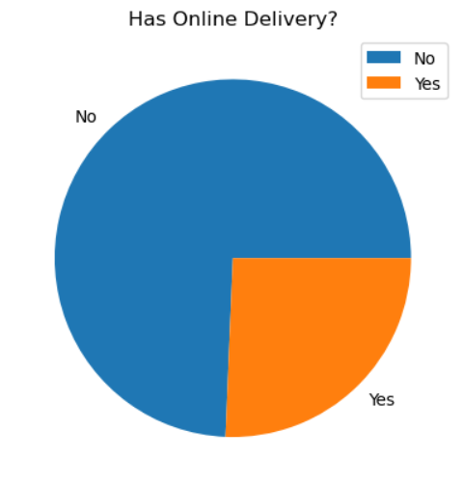
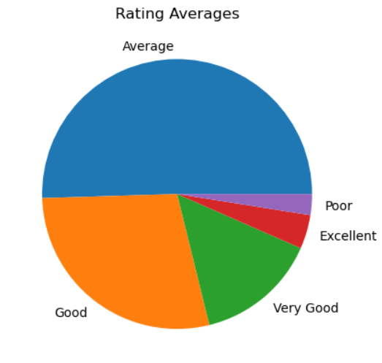
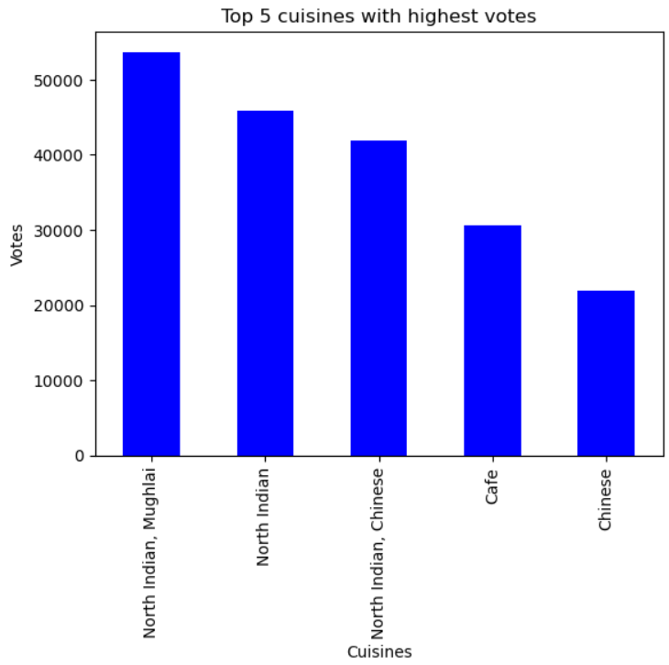
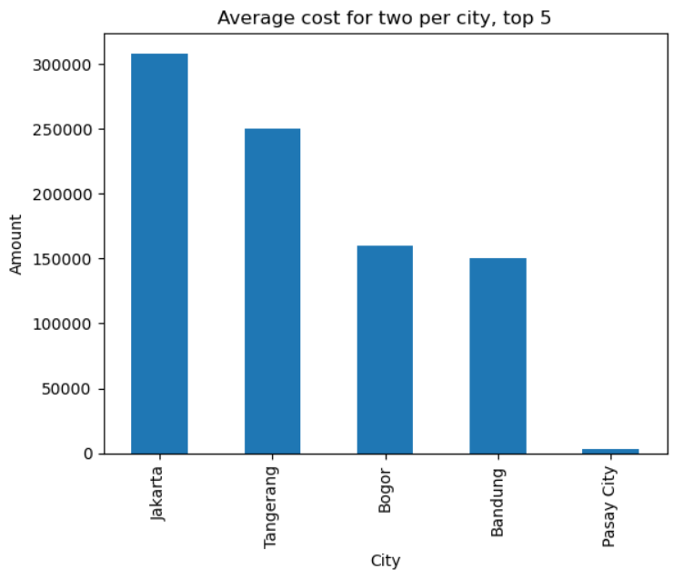
EDA
The dataset had missing values in the Cuisines column, which were filled with 'Unknown’.
Market Insights: Cities and cuisines analysis provides clear indicators of where and what type of restaurant businesses might thrive.
Customer Preferences: Understanding the most popular cuisines and the general satisfaction level helps in tailoring offerings to meet customer expectations.
Operational Strategies: Insights into online delivery adoption and pricing strategies can help restaurants align with current industry trends.
Quality and Satisfaction: The distribution of ratings provides a benchmark for quality and customer satisfaction, which are crucial for sustained success in the restaurant industry.

Slide 13
FEATURE SELECTION AND DATASET
INTRODUCTION
Predicting Restaurant Ratings
EDA
METHODOLOGY AND ALGORITHMS
CONCLUSION

Slide 14

ALGORITHMS
Linear Regression
Support Vector Regression (SVR)
Decision Tree Regressor
Random Forest Regressor
K-Nearest Neighbors Regressor (KNN)
AdaBoost Regressor
Linear Regression
Support Vector Regression (SVR)
Decision Tree
Regressor
Random Forest Regressor
K-Nearest Neighbors Regressor
AdaBoost Regressor

Slide 15
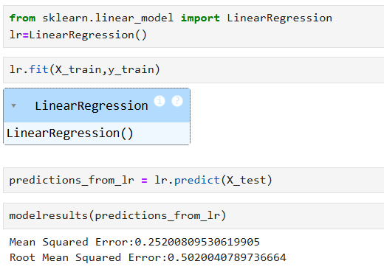
Linear Regression
A simple regression model that assumes a linear relationship between the input features and the target variable.
It aims to find the best-fit line that minimizes the sum of squared errors.

Slide 16
ALGORITHMS
Linear Regression
Support Vector Regression (SVR)
Decision Tree Regressor
Random Forest Regressor
K-Nearest Neighbors Regressor (KNN)
AdaBoost Regressor
Linear Regression
Support Vector Regression (SVR)
Decision Tree
Regressor
Random Forest Regressor
K-Nearest Neighbors Regressor
AdaBoost Regressor

Slide 17
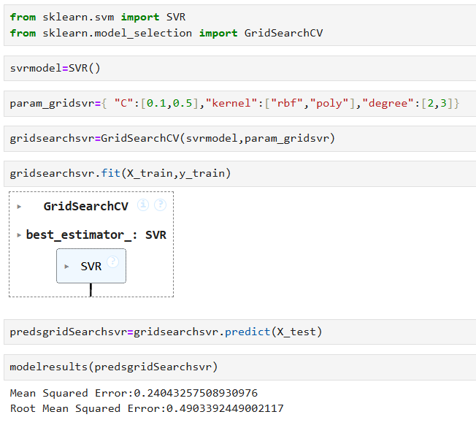
Support Vector Regression (SVR)
SVR is based on the concept of Support Vector Machines (SVM).
It tries to fit the best line within a specified margin, ignoring errors as long as they are within the margin.
It is effective for high-dimensional datasets.

Slide 18
ALGORITHMS
Linear Regression
Support Vector Regression (SVR)
Decision Tree Regressor
Random Forest Regressor
K-Nearest Neighbors Regressor (KNN)
AdaBoost Regressor
Linear Regression
Support Vector Regression (SVR)
Decision Tree
Regressor
Random Forest Regressor
K-Nearest Neighbors Regressor
AdaBoost Regressor

Slide 19
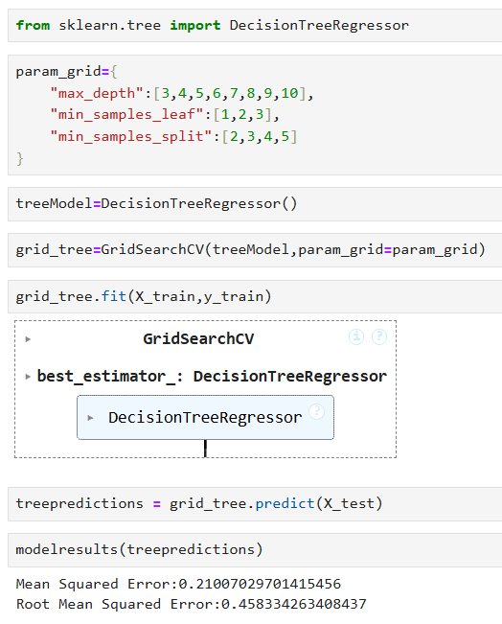
Decision Tree Regressor
A tree-based model that splits the data into subsets based on the value of input features.
Each split aims to minimize the variance in the target variable within the subsets.
It is easy to interpret but can overfit on the training data.

Slide 20
ALGORITHMS
Linear Regression
Support Vector Regression (SVR)
Decision Tree Regressor
Random Forest Regressor
K-Nearest Neighbors Regressor (KNN)
AdaBoost Regressor
Linear Regression
Support Vector Regression (SVR)
Decision Tree
Regressor
Random Forest Regressor
K-Nearest Neighbors Regressor
AdaBoost Regressor

Slide 21
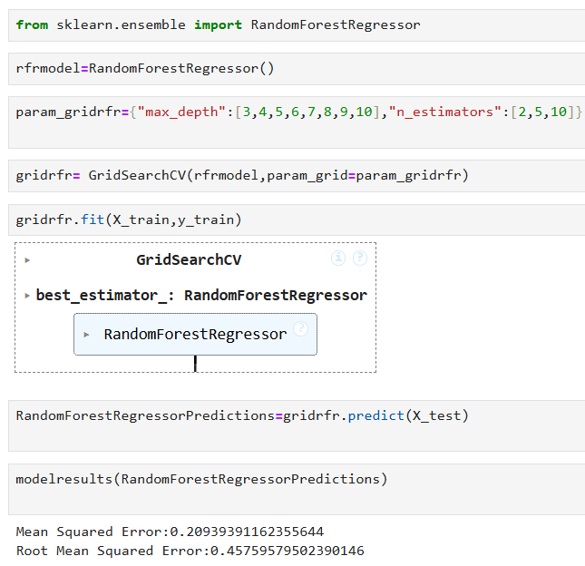
Random Forest Regressor
An ensemble method that combines multiple decision trees to improve prediction accuracy.
Each tree is trained on a random subset of the data, and the final prediction is the average of all tree predictions.
It reduces overfitting compared to a single decision tree.

Slide 22
ALGORITHMS
Linear Regression
Support Vector Regression (SVR)
Decision Tree Regressor
Random Forest Regressor
K-Nearest Neighbors Regressor (KNN)
AdaBoost Regressor
Linear Regression
Support Vector Regression (SVR)
Decision Tree
Regressor
Random Forest Regressor
K-Nearest Neighbors Regressor
AdaBoost Regressor

Slide 23
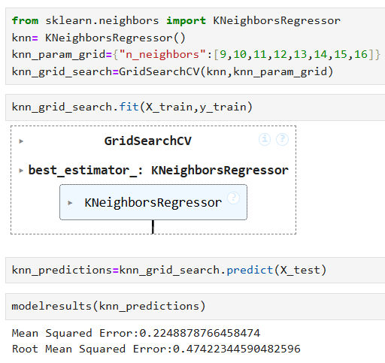
K-Nearest Neighbors Regressor (KNN)
A non-parametric method that predicts the target by averaging the values of the k-nearest neighbors.
It is simple and intuitive but can be computationally expensive for large datasets.

Slide 24
ALGORITHMS
Linear Regression
Support Vector Regression (SVR)
Decision Tree Regressor
Random Forest Regressor
K-Nearest Neighbors Regressor (KNN)
AdaBoost Regressor
Linear Regression
Support Vector Regression (SVR)
Decision Tree
Regressor
Random Forest Regressor
K-Nearest Neighbors Regressor
AdaBoost Regressor

Slide 25
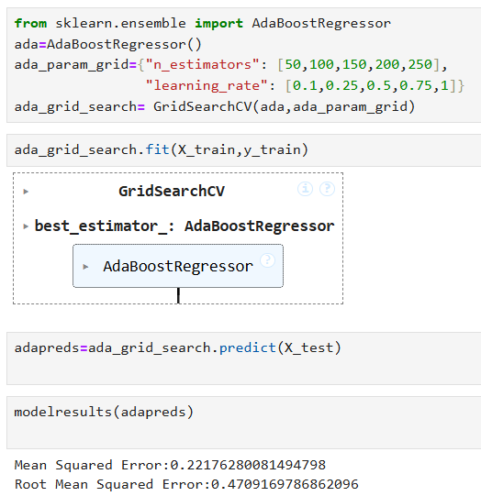
AdaBoost Regressor
An ensemble method that combines multiple weak learners (typically decision trees) to create a strong predictive model.
It adjusts the weights of weak learners based on their performance, focusing more on difficult-to-predict instances.
It can handle various types of data and improve model robustness.

Slide 26
ALGORITHMS
Linear Regression
Support Vector Regression (SVR)
Decision Tree Regressor
Random Forest Regressor
K-Nearest Neighbors Regressor (KNN)
AdaBoost Regressor
Linear Regression
Support Vector Regression (SVR)
Decision Tree
Regressor
Random Forest Regressor
K-Nearest Neighbors Regressor
AdaBoost Regressor

Slide 27
FEATURE SELECTION AND DATASET
INTRODUCTION
Predicting Restaurant Ratings
EDA
METHODOLOGY AND ALGORITHMS
CONCLUSION

Slide 28
CONCLUSION
The Random Forest Regressor is recommended as the best model for predicting restaurant ratings, offering the lowest error rates among all the models tested.

Slide 29


